Slide 1

Exam DP-201: Designing a Microsoft Azure Data Solution Crash Course
Tim Warner

Slide 2


Tim Warner
Based in Nashville, TN, US
Central time zone
MCT, MVP
Twitter: @TechTrainerTim
Badge: timw.info/dpcert

Slide 3
Day 1 of 2 Agenda
Introduction
Identity and Security Design
Storage Data Design
Monitoring Design

Slide 4
Day 2 of 2 Agenda
Content catch-up
Business Continuity Design
Infrastructure Design
Exam AZ-304 strategy

Slide 5
Course Materials
timw.info/dp201

Slide 6
A Different Kind of Training
We'll learn by doing – at least 80 percent demo
Visual, case study approach
10-minute break at midpoint
I’m here to answer your questions – take advantage of this!
Use the Q&A panel

Slide 7

Session Recordings

Slide 8
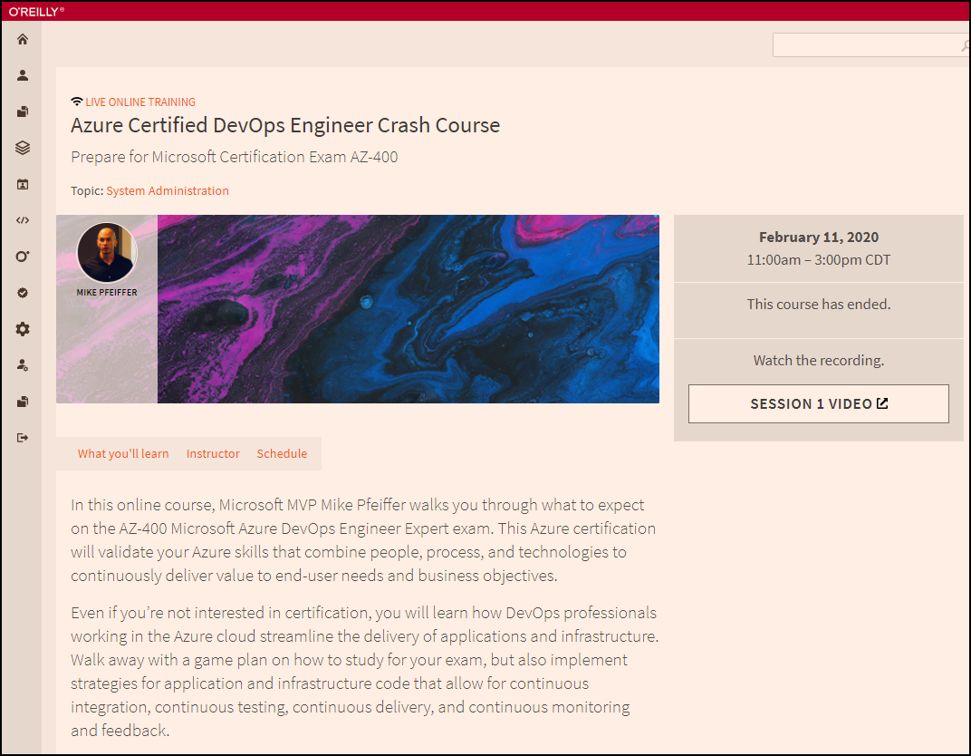
Session Recordings

Slide 9

Session Recordings

Slide 10
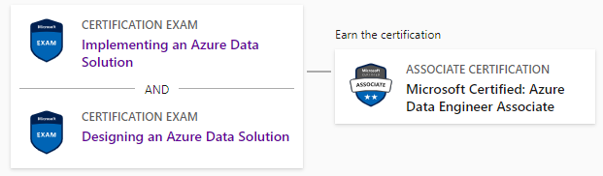
DP-201 Changes in 2021
Until June 30, 2021
DP-200
DP-201

Slide 11

DP-201 Changes in 2021
After June 30, 2021
DP-203
DP-203
DP-203
Data Engineering on Microsoft Azure
Data Engineering on Microsoft Azure

Slide 12
What is an Azure Data Engineer?
Design and implement the management, monitoring, security, and privacy of data using the full stack of data services
“Builds and tunes data pipelines”
“Implements, monitors, and optimizes data platforms”
“Has solid knowledge of SQL, Python, or Scala”
The Azure Data Scientist consumes the data the Engineer provides

Slide 13
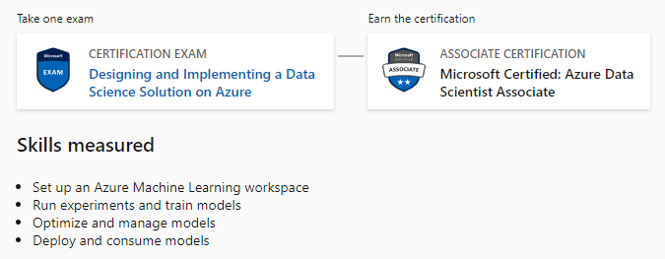
Azure Data Scientist Associate
DP-100

Slide 14
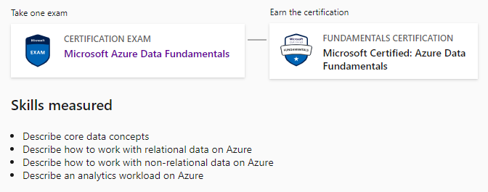
Azure Data Fundamentals
DP-900

Slide 15

Active Screen

Slide 16
Tim's Certification Study Pyramid
Interdependence
Content knowledge
Practical application
Test-taking skills

Slide 17
Thank you!
Course materials: timw.info/dp201
Twitter: @TechTrainerTim
Work: timw.info/ps
Web: TechTrainerTim.com

Slide 18
Storage Account Replication
1
3
3
2
LRS
ZRS

Slide 19
Storage Account Replication
3
3
GRS/RA-GRS

Slide 20
Storage Account Replication
1
3
1
3
2
2
GZRS – RA/GZRS

Slide 21

Always Encrypted

Slide 22
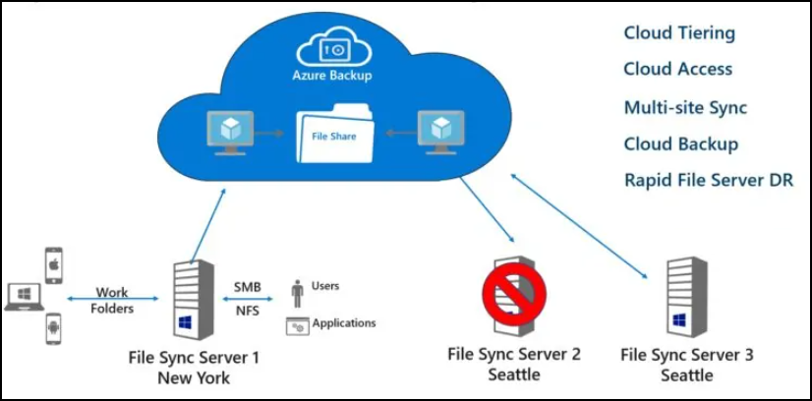
Azure File Sync

Slide 23
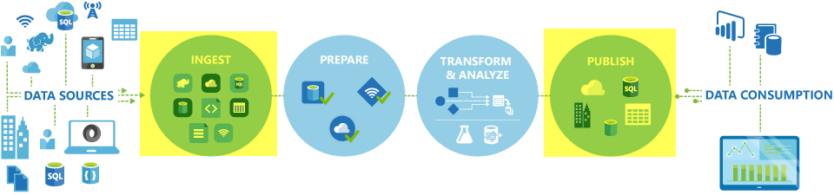
Azure Data Factory

Slide 24

Azure Monitor

Slide 25
Authentication

Slide 26

Tenant vs. Subscription

Slide 27

Hybrid Identity

Slide 28

Azure AD B2C

Slide 29
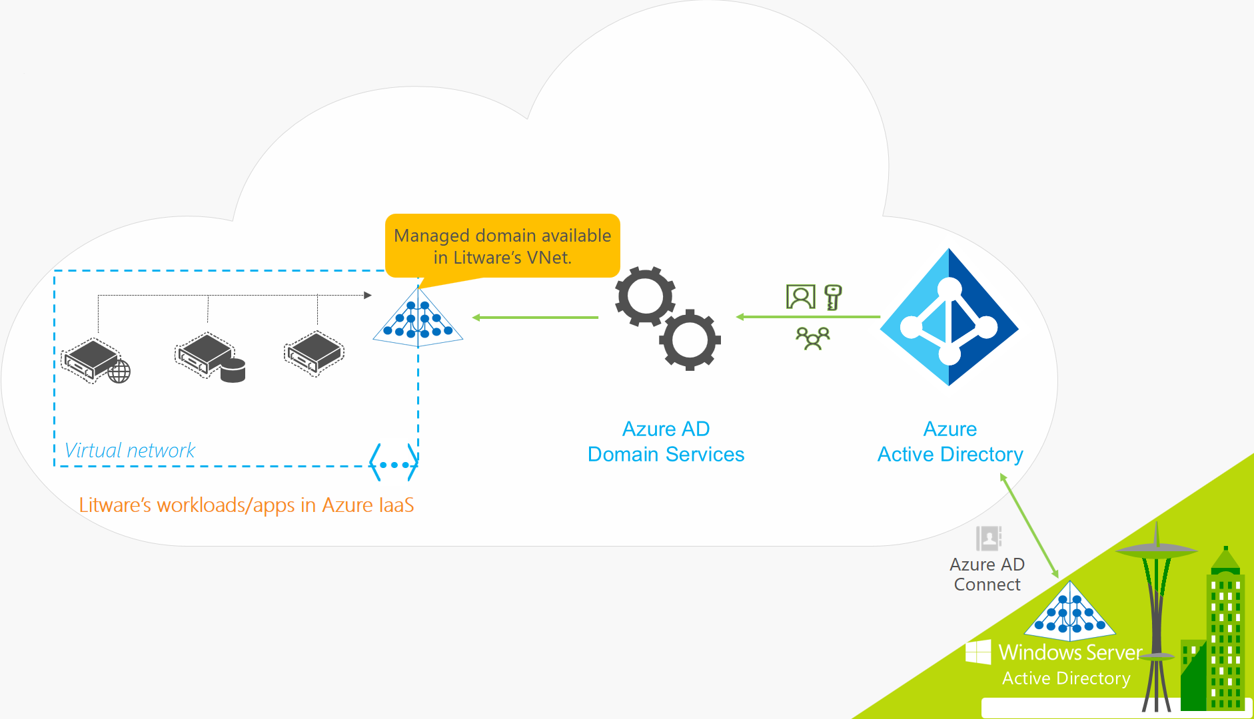
Azure AD Domain Services

Slide 30
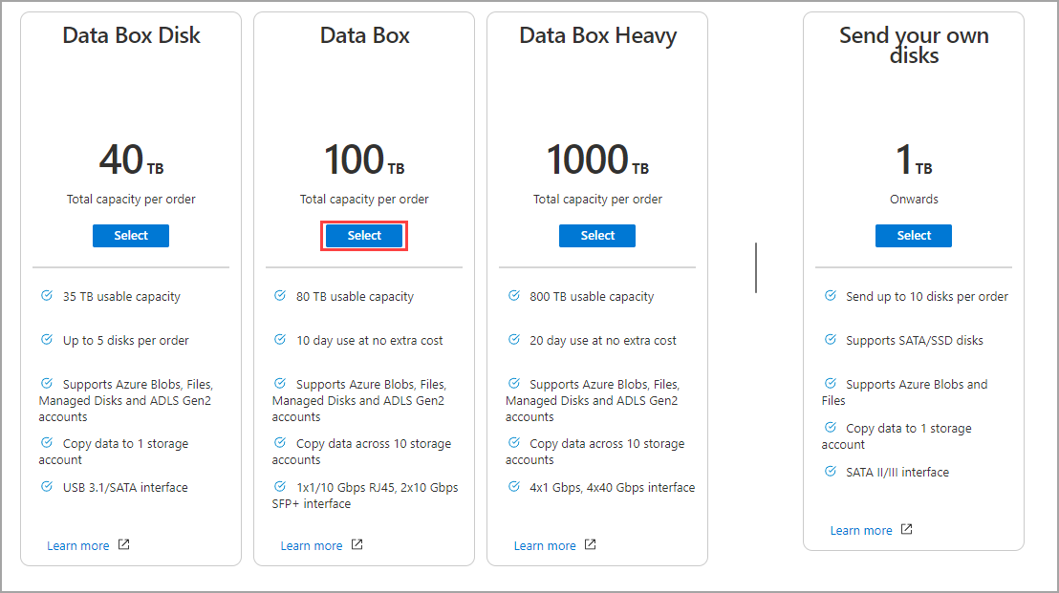
Azure Data Box

Slide 31

Passthrough Authentication

Slide 32

Seamless Single Sign-on

Slide 33
Authorization and Governance

Slide 34

Azure Management Scopes
/ Tenant Root

Slide 35
Azure Storage

Slide 36

Data Pipelines

Slide 37
Monitoring

Slide 38
Azure Diagnostics

Slide 39

Log Analytics

Slide 40

Sentinel

Slide 41
Migration and Disaster Recovery

Slide 42

Azure Backup

Slide 43

Azure Site Recovery

Slide 44
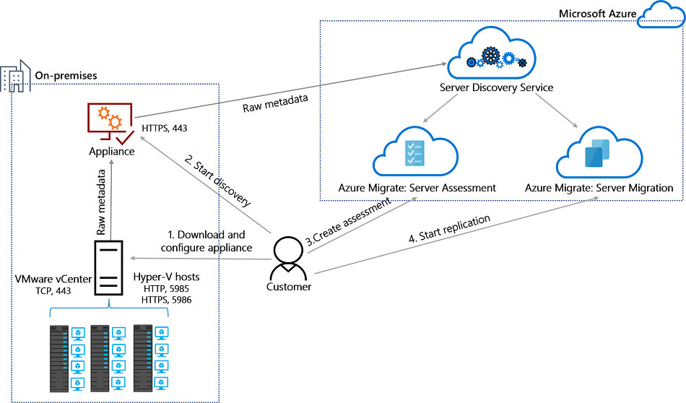
Azure Migrate

Slide 45
Azure Compute

Slide 46

VM Scale Sets

Slide 47
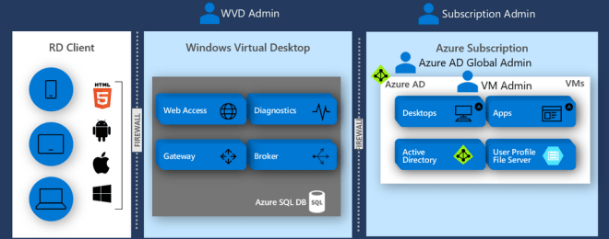
Windows Virtual Desktop (WVD)
timw.info/travis

Slide 48

Availability Set

Slide 49

Availability Zone

Slide 50
Load Balancing

Slide 51

VM Networking

Slide 52

Load Balancing

Slide 53

VNet Peering

Slide 54

Hybrid Networking

Slide 55

Network Virtual Appliance

Slide 56

Azure Load Balancer

Slide 57

Application Gateway

Slide 58

Traffic Manager

Slide 59

Front Door Service

Slide 60
Containers

Slide 61


Docker Container Lifecycle
https://timw.info/3635f

Slide 62
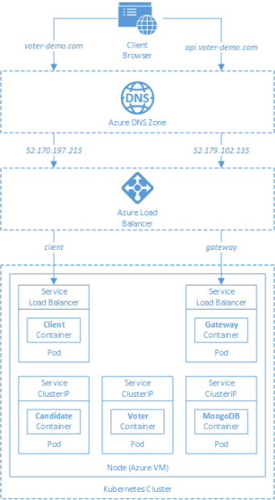
AKS

Slide 63
App Architecture

Slide 64

Event Architecture

Slide 65

Event Architecture

Slide 66
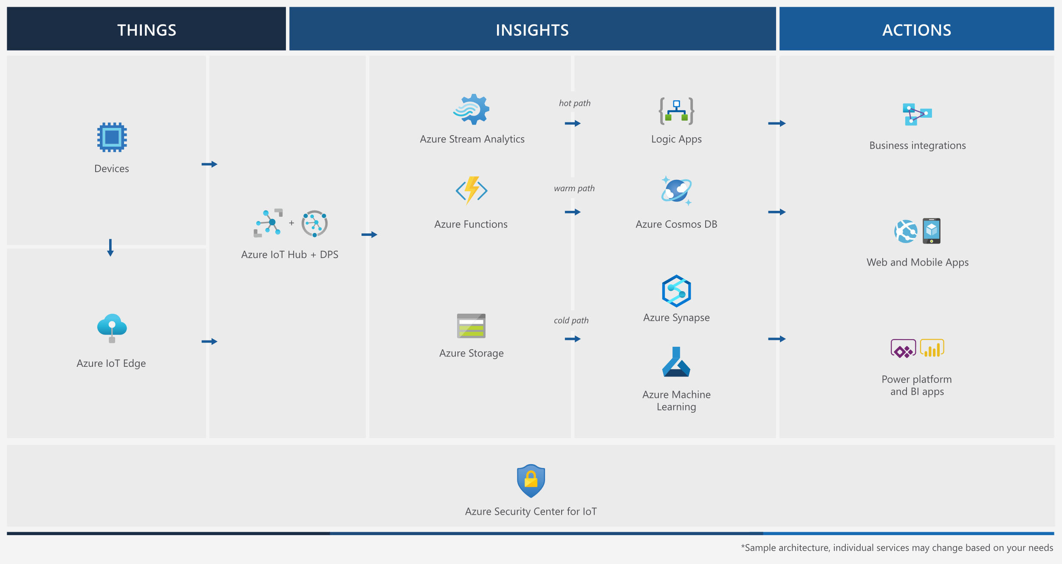
Event Architecture

Slide 67
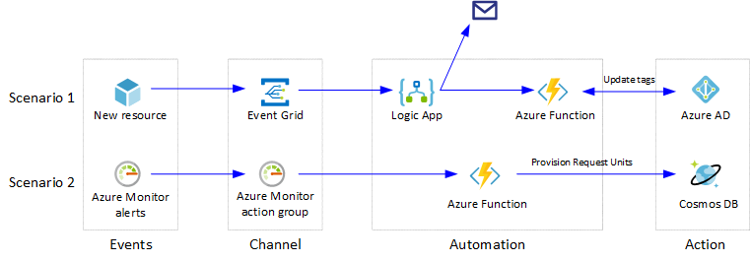
Event Architecture

Slide 68
Exam AZ-304 Item Types

Slide 69

Multiple Choice

Slide 70
Repeated Scenario
You need to move an Azure VM to another hardware host.
Solution: You redeploy the VM.
Does this solution meet the goal?
Yes
No

Slide 71

Select and Place

Slide 72

Build List and Reorder

Slide 73
Active Screen/Fill in the Blank

Slide 74

Case Study

Slide 75






Performance-Based Lab

Slide 76
Microsoft Online Testing

Slide 77
Microsoft Online Testing Process
timw.info/online

Slide 78

Microsoft Online Testing Process

Slide 79

Microsoft Online Testing Process

Slide 80

Microsoft Online Testing Process

Slide 81

Microsoft Online Testing Process

Slide 82

Microsoft Online Testing Process

Slide 83

Microsoft Online Testing Process

Slide 84

Microsoft Online Testing Process

Slide 85
AZ-304 Exam Strategy
Focus your skills accordingly:
60 percent Azure portal
20 percent Azure PowerShell
10 percent Azure CLI
10 percent KQL
Expect performance-based labs, but be thankful if you don't see 'em

Slide 86
Thank you!
Course materials: timw.info/az304
Twitter: @TechTrainerTim
Work: timw.info/ps
Web: TechTrainerTim.com

